Slide 1

Geology Merit Badge
Troop 344 and 9344 Pemberville, OH

Slide 2

Geology Merit Badge Requirements
Define geology. Discuss how geologists learn about rock formations. In geology, explain why the study of the present is important to understanding the past.
Pick three resources that can be extracted or mined from Earth for commercial use. Discuss with your counselor how each product is discovered and processed.
Review a geologic map of your area or an area selected by your counselor, and discuss the different rock types and estimated ages of rocks represented. Determine whether the rocks are horizontal, folded, or faulted, and explain how you arrived at your conclusion.

Slide 3
Geology Merit Badge Requirements
Do ONE of the following:
  With your parent's and counselor's approval, visit with a geologist, land use planner, or civil engineer. Discuss this professional's work and the tools required in this line of work. Learn about a project that this person is now working on, and ask to see reports and maps created for this project. Discuss with your counselor what you have learned.
  Find out about three career opportunities available in geology. Pick one and find out the education, training, and experience required for the profession. Discuss this with your counselor, and explain why this profession might interest you.

Slide 4
Geology Merit Badge Requirements
Do ONE of the following (a OR b OR c OR d):
  Surface and Sedimentary Processes Option
    Conduct an experiment approved by your counselor that demonstrates how sediments settle from suspension in water. Explain to your counselor what the exercise shows and why it is important.
    Using topographical maps provided by your counselor, plot the stream gradients (different elevations divided by distance) for four different stream types (straight, meandering, dendritic, trellis). Explain which ones flow fastest and why, and which ones will carry larger grains of sediment and why.
    On a stream diagram, show areas where you will ,find the following features: cut bank, fill bank, point bar, medial channel bars, lake delta. Describe the relative sediment grain size found in each feature.
    Conduct an experiment approved by your counselor that shows how some sedimentary material carried by water may be too small for you to see without a magnifier.
    Visit a nearby stream. Find clues that show the direction of water flow, even if the water is missing. Record your observations in a notebook, and sketch those clues you observe. Discuss your observations with your counselor.

Slide 5
Geology Merit Badge Requirements
Do ONE of the following (a OR b OR c OR d):
  Energy Resources Option
    List the top five Earth resources used to generate electricity in the United States.
    Discuss source rock, trap, and reservoir rock - the three components necessary for the occurrence of oil and gas underground.
    Explain how each of the following items is used in subsurface exploration to locate oil or gas: reflection seismic, electric well logs, stratigraphic correlation, offshore platform, geologic map, subsurface structure map, subsurface isopach map, and core samples and cutting samples.
    Using at least 20 data points provided by your counselor, create a subsurface structure map and use it to explain how subsurface geology maps are used to find oil, gas, or coal resources.
    Do ONE of the following activities:
      Make a display or presentation showing how oil and gas or coal is found, extracted, and processed. You may use maps, books, articles from periodicals, and research found on the Internet (with your parent's permission). Share the display with your counselor or a small group (such as your class at school) in a five minute presentation.
      With your parent's and counselor's permission and assistance, arrange for a visit to an operating drilling rig. While there, talk with a geologist and ask to see what the geologist does onsite. Ask to see cutting samples taken at the site.

Slide 6
Geology Merit Badge Requirements
Do ONE of the following (a OR b OR c OR d):
  Mineral Resources Option
    Define rock. Discuss the three classes of rocks including their origin and characteristics.
    Define mineral. Discuss the origin of minerals and their chemical composition and identification properties, including hardness, specific gravity, color, streak, cleavage, luster, and crystal form.
    Do ONE of the following:
      Collect 10 different rocks or minerals. Record in a notebook where you obtained (found, bought, traded) each one. Label each specimen, identify its class and origin, determine its chemical composition, and list its physical properties. Share your collection with your counselor.
      With your counselor's assistance, identify 15 different rocks and minerals. List the name of each specimen, tell whether it is a rock or mineral, and give the name of its class (if it is a rock) or list its identifying physical properties (if it is a mineral).

Slide 7
Geology Merit Badge Requirements
Do ONE of the following (a OR b OR c OR d):
  Mineral Resources Option
    List three of the most common road building materials used in your area. Explain how each material is produced and how each is used in road building.
    Do ONE of the following activities:
      With your parent's and counselor's approval, visit an active mining site, quarry, or sand and gravel pit. Tell your counselor what you learned about the resources extracted from this location and how these resources are used by society.
      With your counselor, choose two examples of rocks and two examples of minerals. Discuss the mining of these materials and describe how each is used by society.
      With your parent's and counselor's approval, visit the office of a civil engineer and learn how geology is used in construction. Discuss what you learned with your counselor.

Slide 8
Geology Merit Badge Requirements
Do ONE of the following (a OR b OR c OR d):
  Earth History Option
    Create a chart showing suggested geological eras and periods. Determine which period the rocks in your region might have been formed.
    Explain the theory of plate tectonics. Make a chart explaining, or discuss with your counselor, how the processes of plate tectonics work. Discuss how plate tectonics determines the distribution of most of the Earth's volcanoes, earthquakes, and mountain belts.
    Explain to your counselor the processes of burial and fossilization, and discuss the concept of extinction.
    Explain to your counselor how fossils provide information about ancient life, environment, climate, and geography. Discuss the following terms and explain how animals from each habitat obtain food: benthonic, pelagic, littoral, lacustrine, open marine, brackish, fluvial, eolian, protected reef.

Slide 9
Geology Merit Badge Requirements
Do ONE of the following (a OR b OR c OR d):
  Earth History Option
    Collect 10 different fossil plants or animals OR (with your counselor's assistance) identify 15 different fossil plants or animals. Record in a notebook where you obtained (found, bought, traded) each one. Classify each specimen to the best of your ability, and explain how each one might have survived and obtained food. Tell what else you can learn from these fossils.
    Do ONE of the following:
      Visit a science museum or the geology department of a local university that has fossils on display. With your parent's and counselor's approval, before you go, make an appointment with a curator or guide who can show you how the fossils are preserved and prepared for display.
      Visit a structure in your area that was built using fossiliferous rocks. Determine what kind of rock was used and tell your counselor the kinds of fossil evidence you found there.
      Visit a rock outcrop that contains fossils. Determine what kind of rock contains the fossils, and tell your counselor the kinds of fossil evidence you found at the outcrop.
      Prepare a display or presentation on your state fossil. Include an image of the fossil, the age of the fossil, and its classification. You may use maps, books, articles from periodicals, and research found on the Internet (with your parent's permission). Share the display with your counselor or a small group (such as your class at school). If your state does not have a state fossil, you may select a state fossil from a neighboring state.

Slide 10
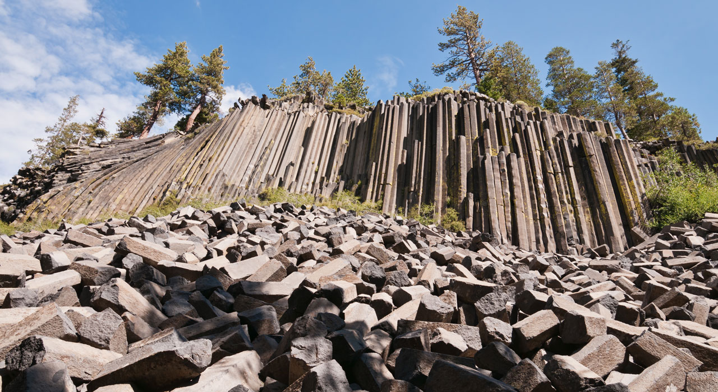
Requirement #1
Define geology. Discuss how geologists learn about rock formations. In geology, explain why the study of the present is important to understanding the past.

Slide 11
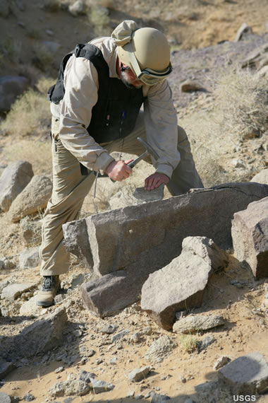
Geology
"Geo" means earth, and "logy" means science or study of.
Geology is the science that studies the earth and the rocks it is made of, and the changes and processes the earth has had and is now experiencing.

Slide 12
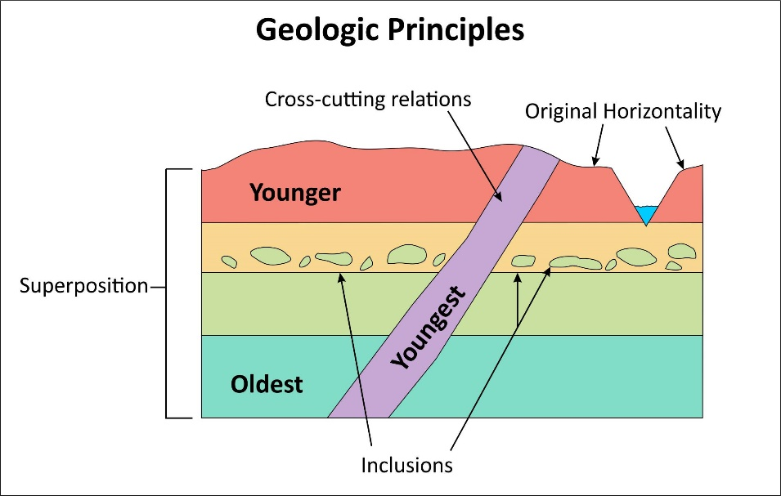
Understanding Rock Formations
The concepts of: superposition (younger layers on top), stratigraphy (how layers form), and structural geology (how layers change as in folding) combine to help geologists figure out what’s below using information about the Earth’s surface.

Slide 13
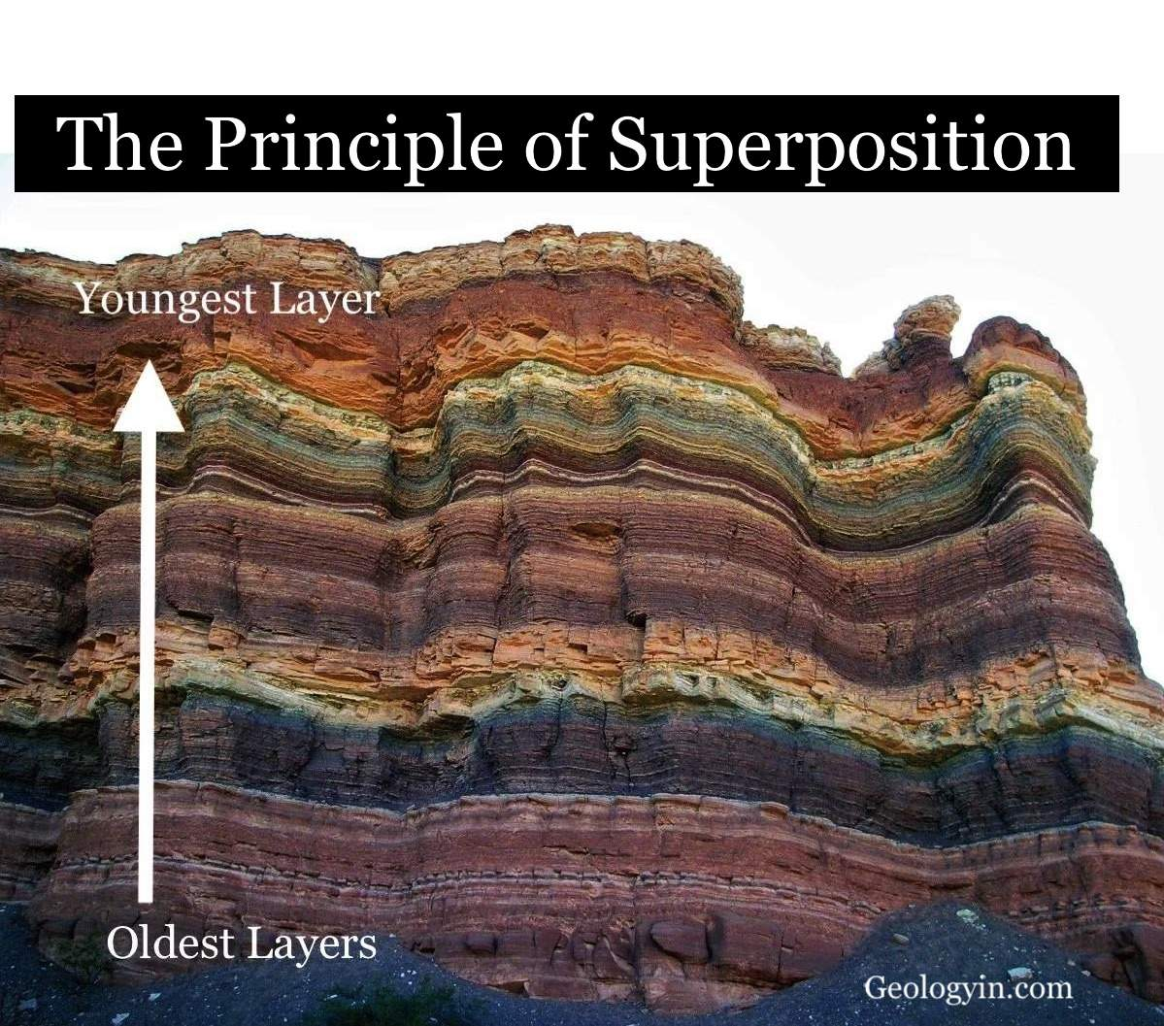
Principals of Geology
Law of superposition
  The law of superposition is one of the principles of geology scientists use to determine the relative ages of rock strata, or layers.
  This principle states that layers of rock are superimposed, or laid down one on top of another.
  The oldest rock strata will be on the bottom and the youngest at the top.

Slide 14
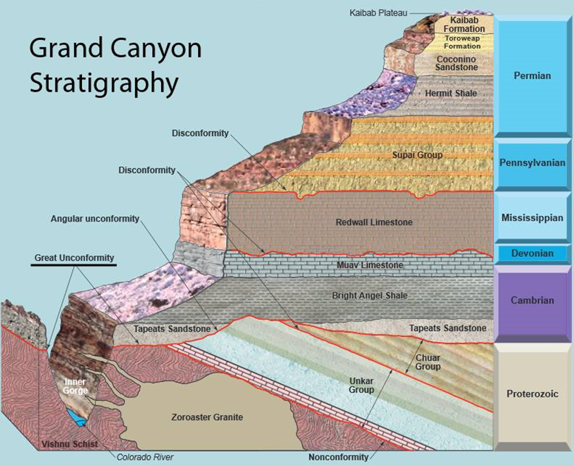
Principals of Geology
Stratigraphy
  The branch of geology concerned with the order and relative position of strata and their relationship to the geological time scale.

Slide 15
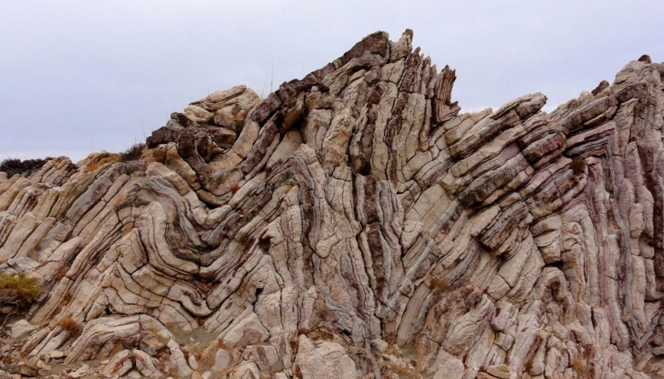
Principals of Geology
Structural geology
  Structural geology is the study of how rocks deform, fold, fracture, and move under different forces and conditions.

Slide 16
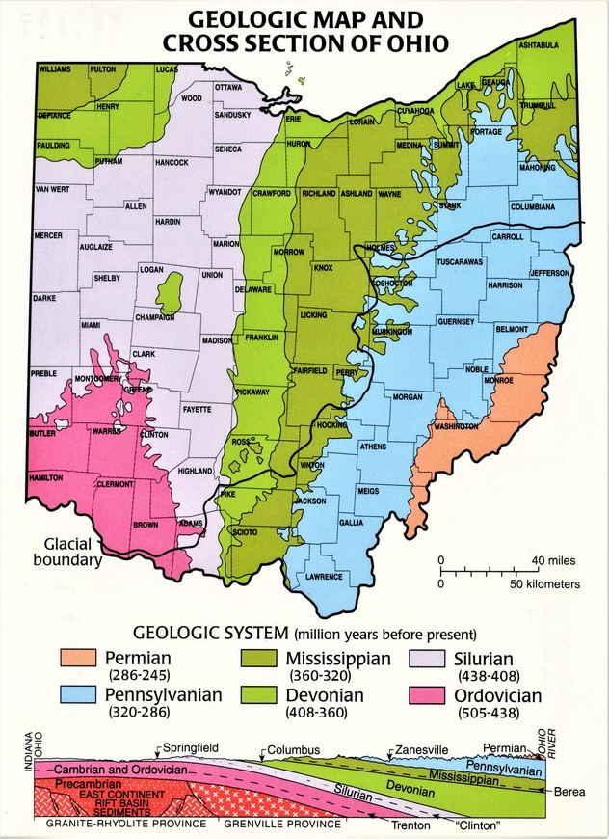
Tools of the Geologist
Geological maps
  Geological maps show where rocks and sediments of the same type and age exist on Earth’s surface.
  Geological maps are important in showing the distribution of rocks of the same age and type.
  Geologists create geological maps from information gathered from direct observation in the field, interpretations of aerial photographs, and satellite data.

Slide 17
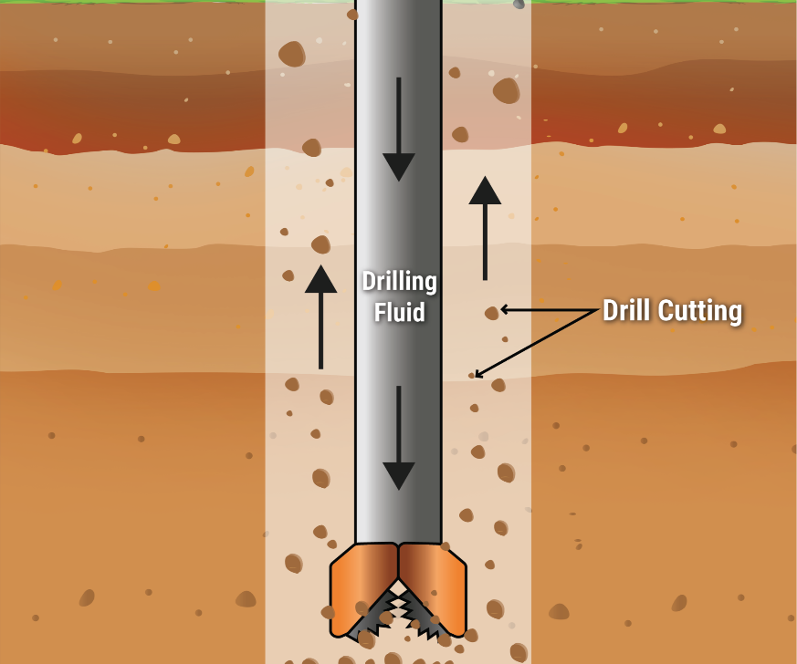
Tools of the Geologist
Well Information
  Wells are pipes that bring water or petroleum to the surface.
  They give us information about Earth’s subsurface, including information about the sequence of beds and structural features many thousands of feet below the surface.

Slide 18
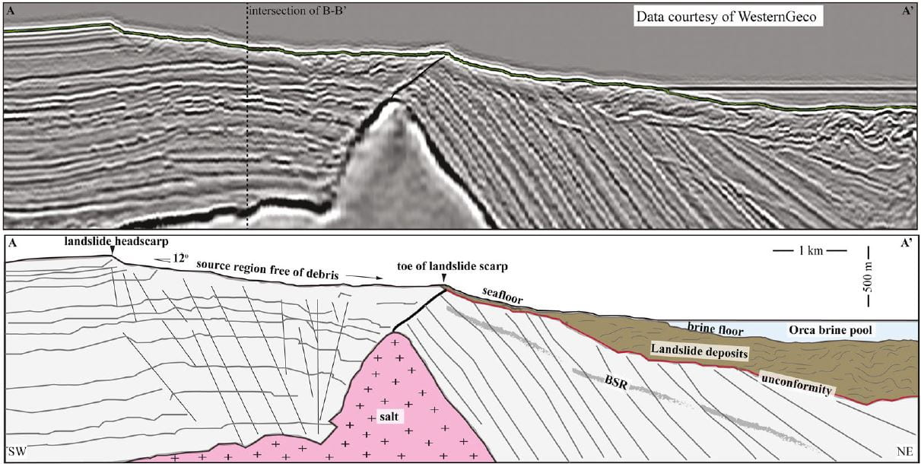
Tools of the Geologist
Reflection Seismology
  Sound waves are sent into Earth to measure the reflections, or echoes, to the tops of various rock layers.
  Seismic reflections give an indirect measure of subsurface rocks and give geologists clues as to what lies under Earth’s surface.

Slide 19
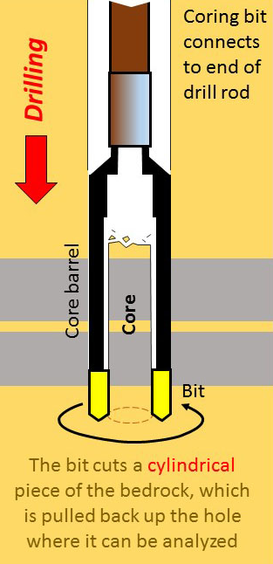
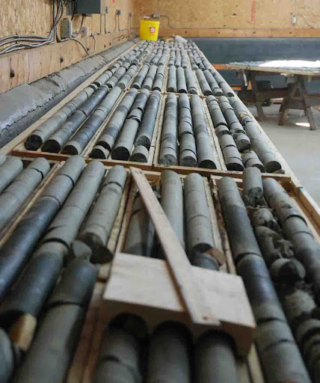
Tools of the Geologist
Core Sampling
  Technique used in underground or undersea exploration and prospecting.
  A core sample is a roughly cylindrical piece of subsurface material removed by a special drill and brought to the surface for examination.

Slide 20
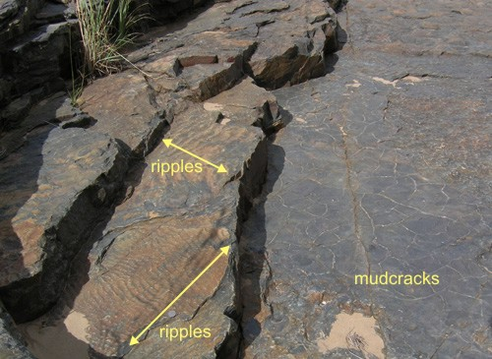
Uniformitarianism
The Principle of Uniformitarianism states that the earth has changed in uniform ways and the present is the key to the past.
  Physical processes at work today on Earth, like wind and water erosion, have always been active and are responsible for many of the features seen on Earth today.
  These natural processes, including erosion and mountain building, occur slowly over time through geologic forces that have been at work since Earth first formed.

Slide 21
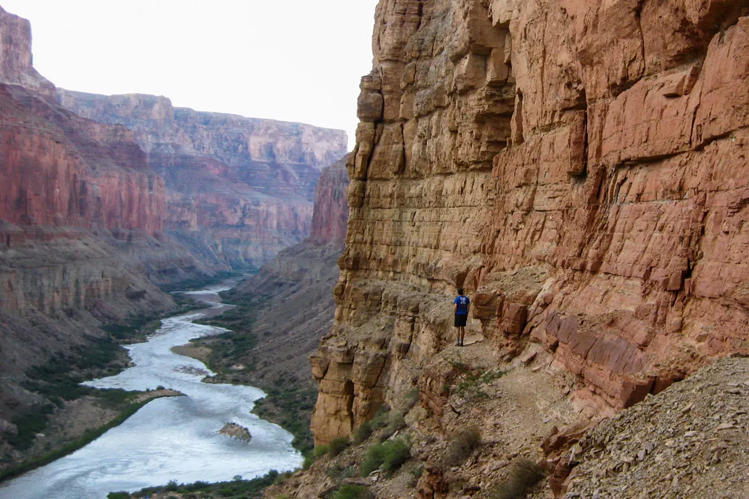
Uniformitarianism
The Grand Canyon in Arizona, USA, is an example where uniformitarianism is used to interpret its formation.
The layers of sedimentary rocks exposed in the Grand Canyon are believed to have been formed over millions of years by the same geological processes that are observed today, such as erosion by the Colorado River and deposition of sediment.
By studying the modern-day erosion rates of the Colorado River and the types of sediment being transported, geologists use the principle of uniformitarianism to infer that the Grand Canyon was formed over a long period of time by the Colorado River through gradual erosion.

Slide 22
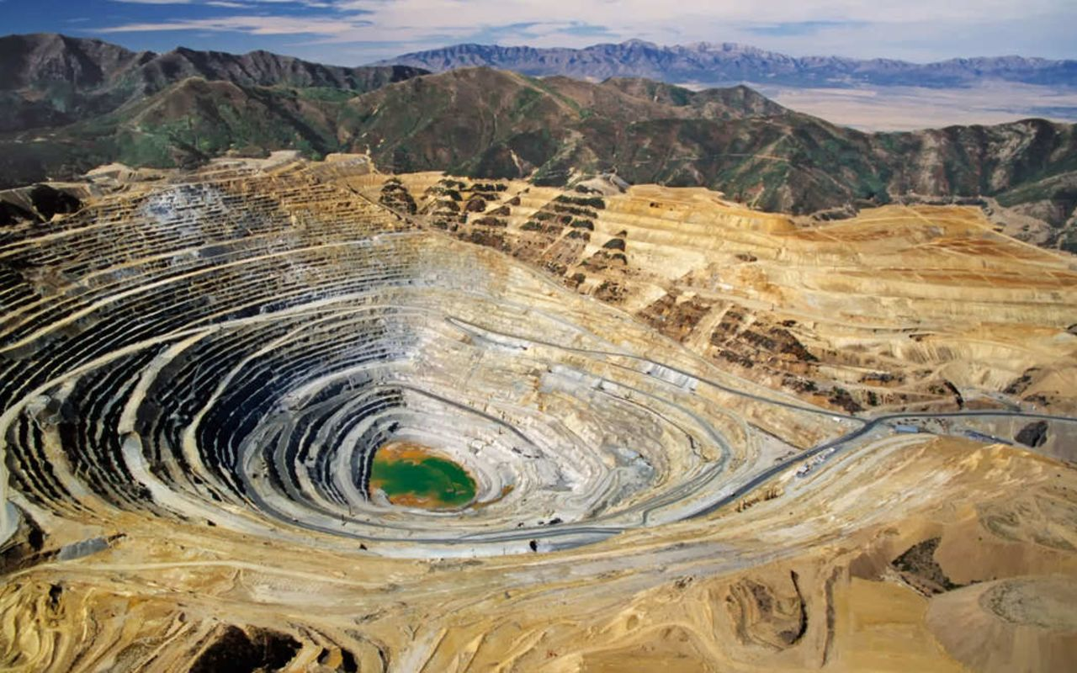
Requirement #2
Pick three resources that can be extracted or mined from Earth for commercial use. Discuss with your counselor how each product is discovered and processed.

Slide 23
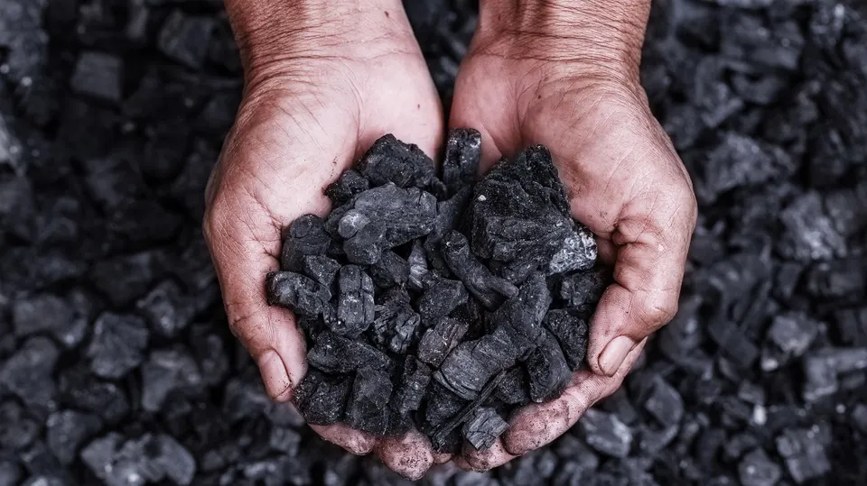
Coal
Coal is a combustible black or brownish-black sedimentary rock with a high amount of carbon and hydrocarbons.
Coal is classified as a nonrenewable energy source because it takes millions of years to form.
Coal contains the energy stored by plants that lived hundreds of millions of years ago in swampy forests.
Layers of dirt and rock covered the plants and over millions of years the resulting pressure and heat turned the plants into the substance we call coal.

Slide 24
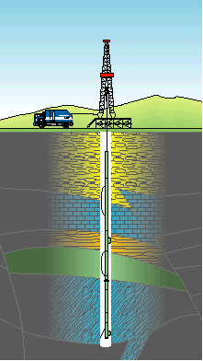
Finding Coal
How do geologists determine the presence of coal seams?
They drill wells and electrically log them.
  Electric logging consists of lowering a device used to measure the electric resistance of the rock layers in the well.
  Coals are typically very low density, and stand out in comparison to other rocks.
They also core them and bring up a sample of the rocks to examine them.
With enough wells, you can map out the location, thickness, and extent of a coal formation you are interested in.

Slide 25
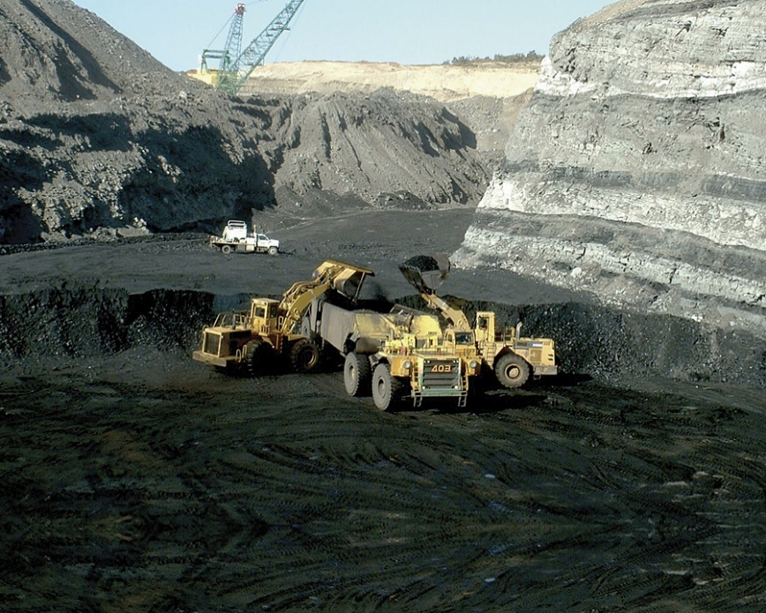
Mining Coal
Surface Mining
  Is often used when coal is less than 200 feet underground.
  In surface mining, large machines remove the topsoil and layers of rock known as overburden to expose coal seams.
  Once the coal seam is exposed, it is drilled, fractured and thoroughly mined in strips.
  The coal is then loaded onto large trucks or conveyors for transport to where it will be used.

Slide 26
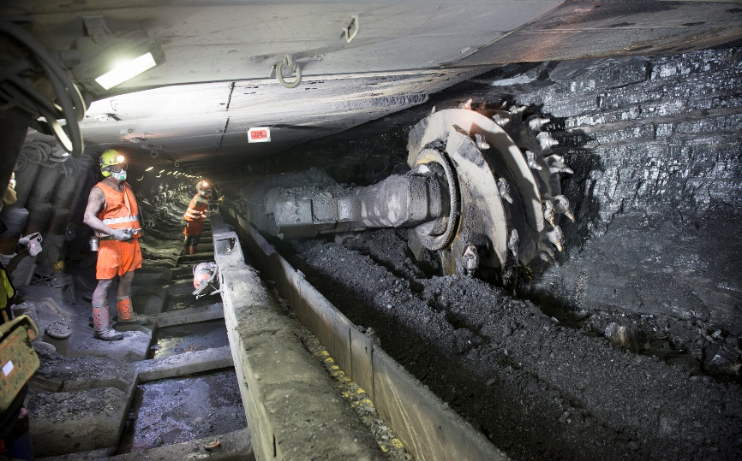
Mining Coal
Underground mining
  Also called deep mining, is used when the coal is more than 200 feet below the surface.
  Some underground mines are thousands of feet deep, with tunnels that may extend out from the vertical mine shafts for miles.
  Miners ride elevators down deep mine shafts and travel on small trains in long tunnels to get to the coal.
  The miners use large machines to dig out coal after which the coal is gathered and loaded onto shuttle cars or conveyors for transport to the surface.

Slide 27
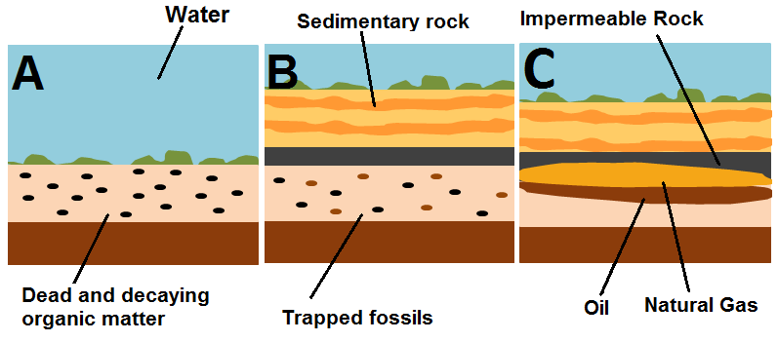
Oil and Natural Gas
Oil and Natural Gas are fossil fuels and non-renewable resources that are formed when layers of organic matter (primarily marine microorganisms) are buried under layers of sand, silt, and rock.
These remains decompose under anaerobic conditions and are subjected to intense heat and pressure underground over millions of years forming oil and natural gas.

Slide 28
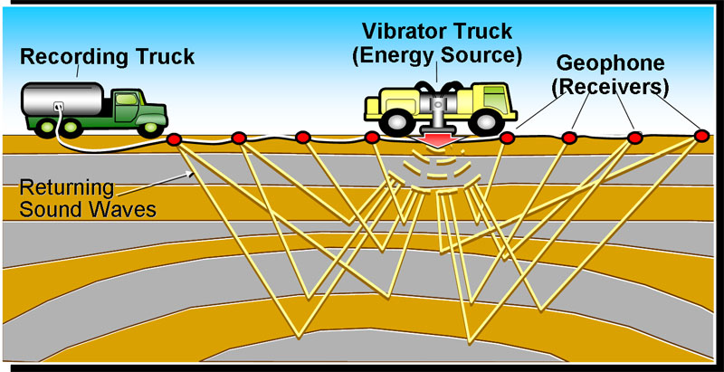
Finding Oil and Natural Gas
Early oil and gas explorers relied upon surface signs like natural oil seeps where petroleum bubbled to the surface of the Earth.
Geologists today often use seismic surveys on land and in the ocean to find the right places to drill wells.
If a site seems promising, an exploratory well is drilled and tested.
If enough oil is found to make it financially worthwhile to pursue, development wells are drilled.
Seismic Survey

Slide 29
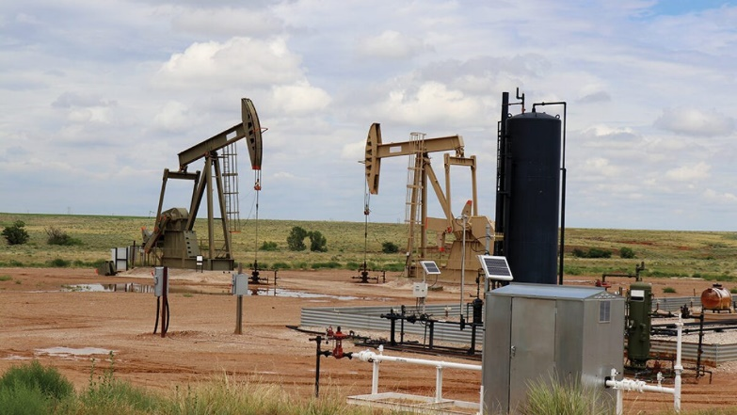
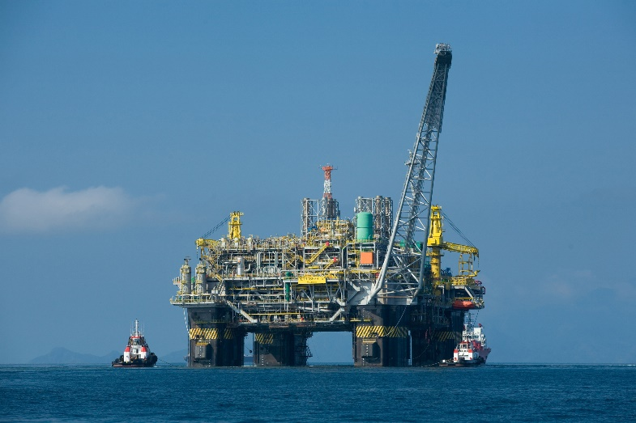
Extracting Oil and Natural Gas
Oil rigs (on land) and oil platforms (off shore) are used to drill long holes into the earth to create an oil well and extract oil and gas with pumps.
After extraction, oil is refined to make gasoline and other products such as tires and asphalt.
Natural gas is sent to processing plants where water vapor and nonhydrocarbon compounds are removed.

Slide 30

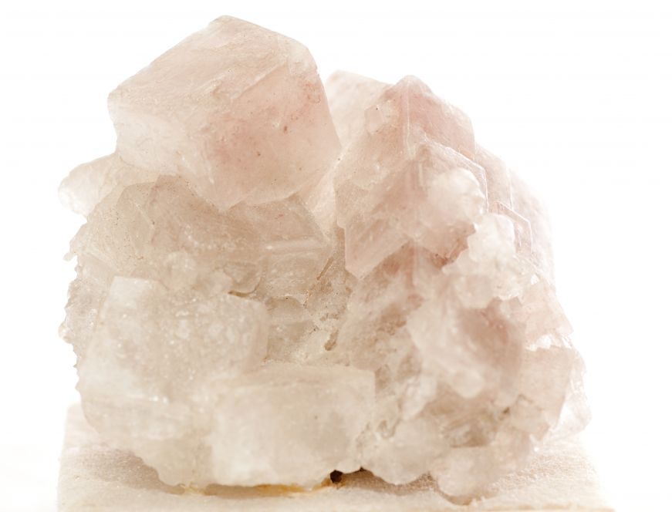
Salt
Salt is a mineral composed primarily of sodium chloride (NaCl).
When used in food, especially in granulated form, it is more formally called table salt.
In the form of a natural crystalline mineral, salt is also known as rock salt or halite.
Salt is essential for life in general, and saltiness is one of the basic human tastes.
Salt is one of the oldest and most common food seasonings and is known to uniformly improve the taste perception of food.
Salting, brining, and pickling are ancient and important methods of food preservation that are still used today.

Slide 31
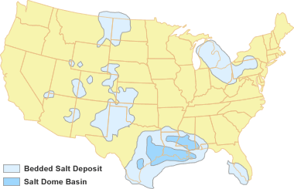
Finding Salt
Salt exists as deposits in ancient seabeds, which became buried through tectonic changes over thousands or millions of years.
Geological mapping is used to locate likely deposits and the size of a deposit is then proved by drilling.
Salt layers can also be located in a borehole by well logging.

Slide 32
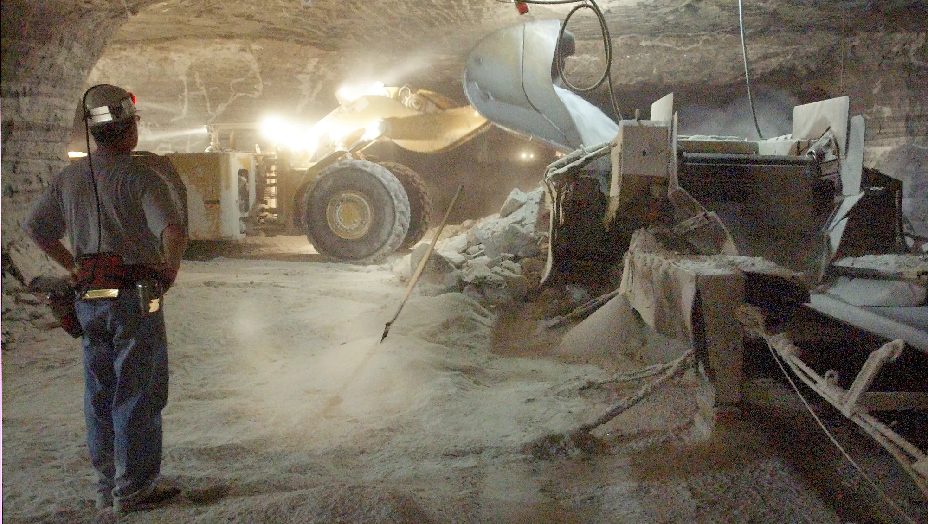
Mining Salt
Many salt mines use the "room and pillar" system of mining.
Shafts are sunk down to the floor of the mine, and rooms are carefully constructed by drilling, cutting and blasting between the shafts, creating a checkerboard pattern.
After the salt is removed and crushed, a conveyor belt hauls it to the surface.
Most salt produced this way is used as rock salt.

Slide 33
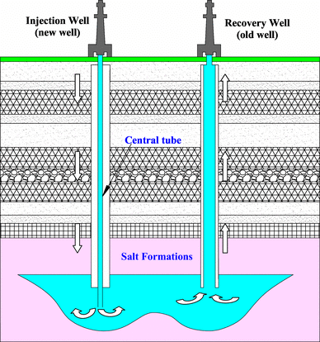
Mining Salt
In solution mining, wells are drilled over salt beds or domes and water is injected to dissolve the salt.
Then the brine is pumped out and taken to a plant where the brine is boiled and then evaporated until the salt is left behind.
Then it is dried and refined.
Most table salt is produced this way.

Slide 34
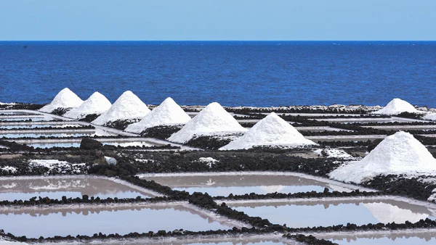
Mining Salt
Salt is harvested through solar evaporation from seawater or salt lakes.
Wind and the sun evaporate the water from shallow pools, leaving the salt behind.
It is usually harvested once a year when the salt reaches a specific thickness.
After harvest, the salt is washed, drained, cleaned and refined.
This is the purest way to harvest salt, often resulting in nearly 100 percent sodium chloride.

Slide 35
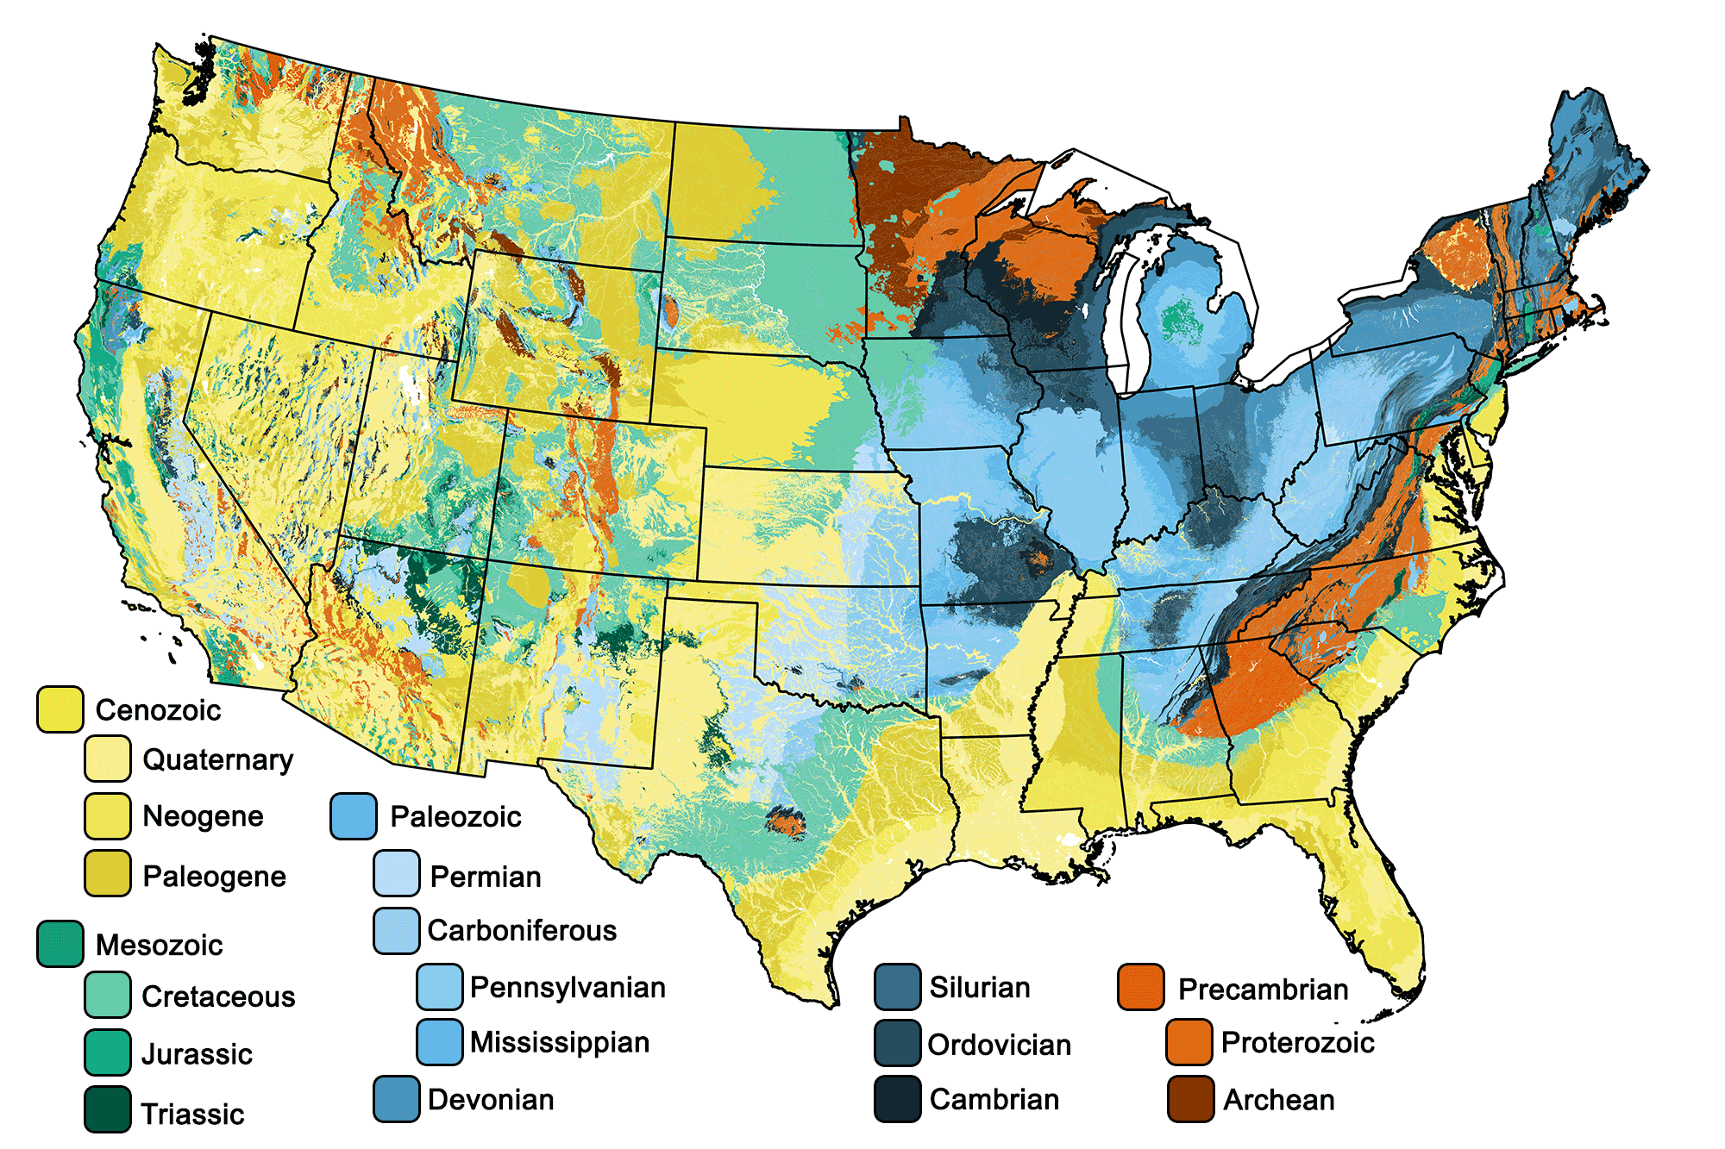
Requirement #3
Review a geologic map of your area or an area selected by your counselor, and discuss the different rock types and estimated ages of rocks represented. Determine whether the rocks are horizontal, folded, or faulted, and explain how you arrived at your conclusion.

Slide 36
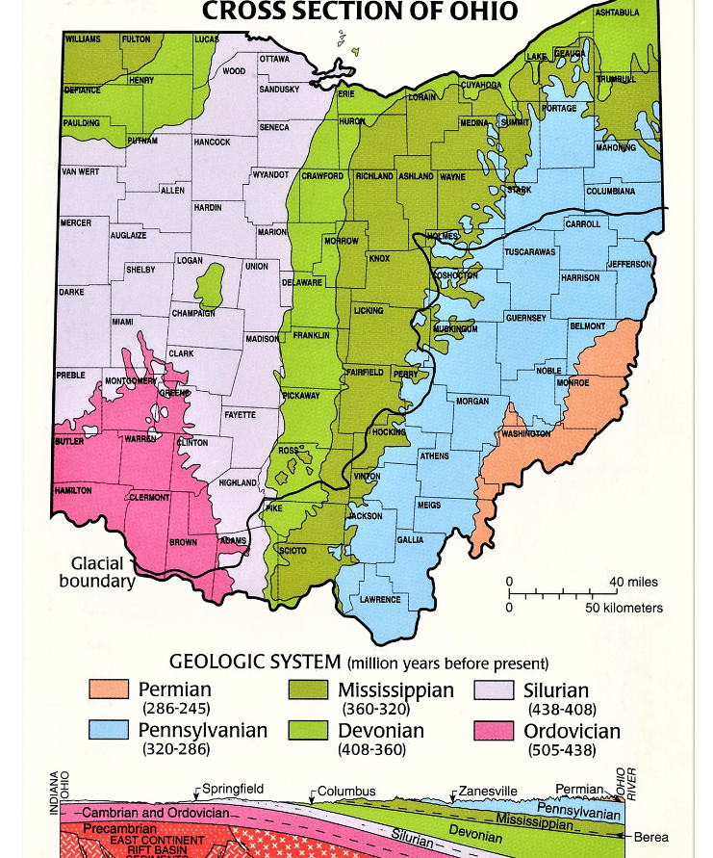
Most of the surface bedrock in Ohio are limestones with the exception of the Devonian sandstones.

Slide 37
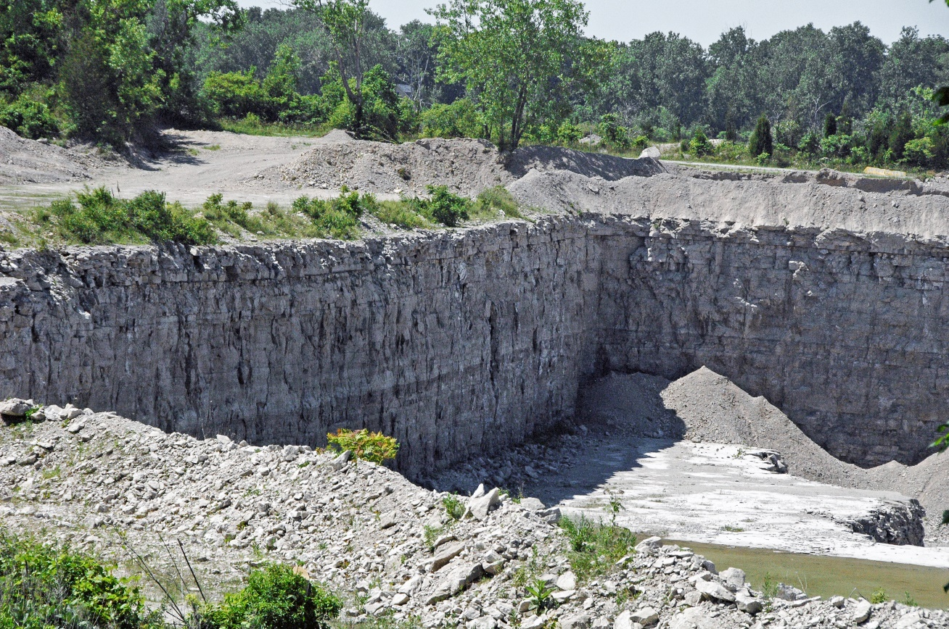
Kelly’s Island Limestone Quarry
Most surface bedrock in Ohio is horizontally layered.

Slide 38
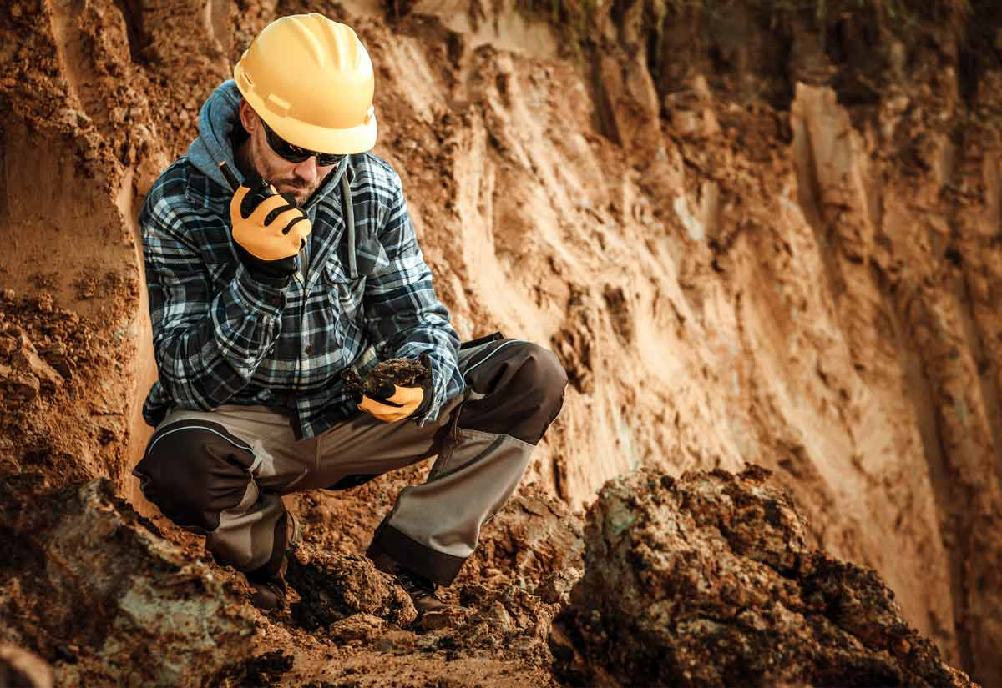
Requirement #4
Do ONE of the following:
  With your parent's and counselor's approval, visit with a geologist, land use planner, or civil engineer. Discuss this professional's work and the tools required in this line of work. Learn about a project that this person is now working on, and ask to see reports and maps created for this project. Discuss with your counselor what you have learned.
  Find out about three career opportunities available in geology. Pick one and find out the education, training, and experience required for the profession. Discuss this with your counselor, and explain why this profession might interest you.

Slide 39
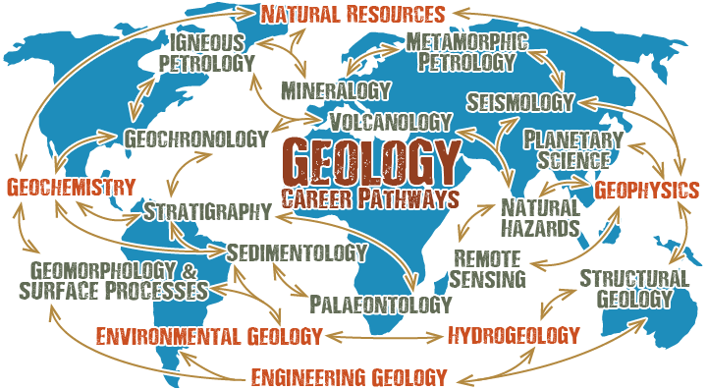
Careers in Geology

Slide 40
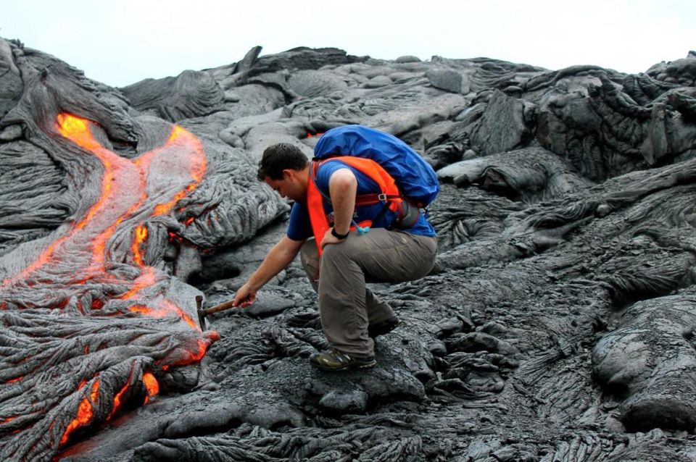
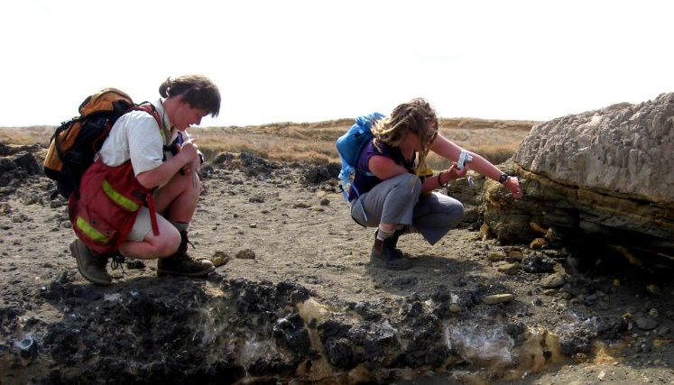
What is a geologist?
Geologists are STEM professionals who study the composition and history of the Earth and other planets, otherwise known as the science of geology.
These professionals study both liquid, gas and solid material to help uncover the natural history of planets, learn more about ecosystems and discover and explore natural resources.

Slide 41
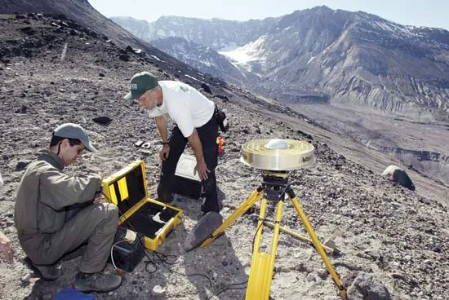
What do geologists do?
The primary duties of a geologist often depend on their job title, qualifications and employer.
Generally, a geologist's responsibilities include:
  Collecting field samples of rocks, soil, liquids and other matters
  Analyzing samples
  Conducting research
  Evaluating possible mining locations
  Using software to create advanced presentations
  Informing others of their studies

Slide 42
Potential Jobs in Geology
Astrogeologist or planetary geologist
Engineering geologist
Environmental consultant
Environmental geologist
Geochemist
Geological surveyor
Geology professor
Geomorphologist
Geophysicist
Gemologist
Glacial geologist
High school science teacher
Hydrogeologist
Mineralogist
Mining geologist
Natural history or natural science museum curator
Oceanographer
Paleontologist
Petrologist
Petroleum geologist
Sedimentologist or soil scientist
Seismologist
Structural geologist
Volcanologist

Slide 43
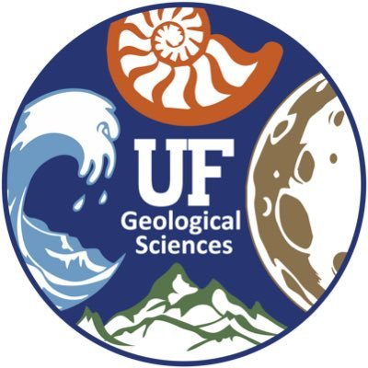
Education required to become a geologist
Geologists have a minimum of a bachelor's degree in order to obtain an entry-level job in the field.
  However, their qualification requirements depend on the field of geology these professionals want to specialize in.
If you are interested in geology research, supervisor positions or teaching the subject, a masters or PhD may be required.
It is also beneficial for professionals to earn a certification relating to their specific study and career path in geology.
  For example, some professional organizations offer certifications in natural resources such as coal or petroleum.

Slide 44
Pay and Career Outlook
The average pay for geologists in the United States was $77,030 in January 2024 according to the ZipRecruiter.
  A geologist’s pay depends on factors such as level of experience, education and training, geographic location, and specific industry.
Overall employment of all geoscientists is projected to grow 5 percent from 2022 to 2032 according to the U.S. Bureau of Labor Statistics.
  This is about as fast as the average growth rate for all occupations.
  The need for energy, environmental protection, and responsible land and resource management is projected to spur demand for geologists in the future.

Slide 45
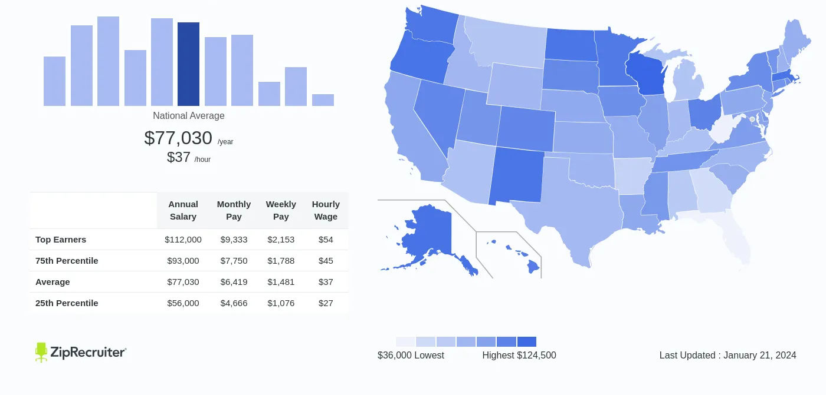
Geologist Salary in the United States

Slide 46
Requirement #5
Do all of the following:
  Surface and Sedimentary Processes Option
    Conduct an experiment approved by your counselor that demonstrates how sediments settle from suspension in water. Explain to your counselor what the exercise shows and why it is important.
    Using topographical maps provided by your counselor, plot the stream gradients (different elevations divided by distance) for four different stream types (straight, meandering, dendritic, trellis). Explain which ones flow fastest and why, and which ones will carry larger grains of sediment and why.
    On a stream diagram, show areas where you will ,find the following features: cut bank, fill bank, point bar, medial channel bars, lake delta. Describe the relative sediment grain size found in each feature.
    Conduct an experiment approved by your counselor that shows how some sedimentary material carried by water may be too small for you to see without a magnifier.
    Visit a nearby stream. Find clues that show the direction of water flow, even if the water is missing. Record your observations in a notebook, and sketch those clues you observe. Discuss your observations with your counselor.

Slide 47
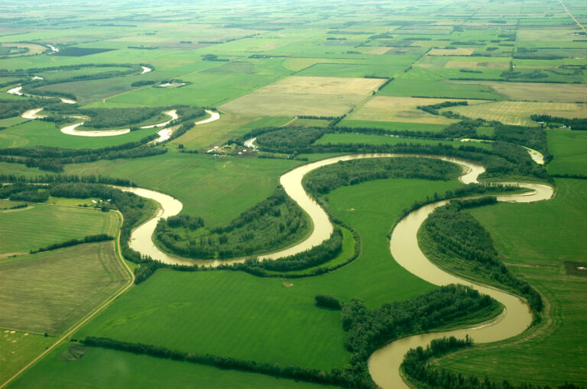
How Do Sediments Settle from Suspension?
Supplies Needed:
Aluminum foil.
Plywood to support the river ~ 14″ x 24,” but anything close to this will work.
Smaller pieces of wood (or books) to prop up your board at a slant.
Dirt.
A jar with a lid.
Clean water.
An empty paper towel roll – helpful, but not essential.

Slide 48
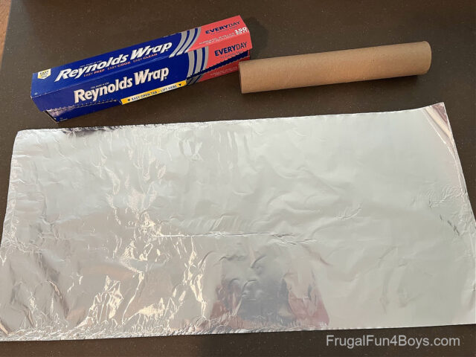
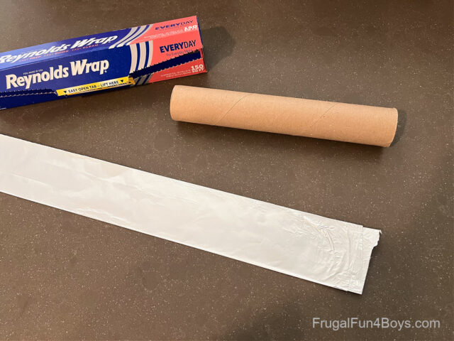
How Do Sediments Settle from Suspension?
First, make your river. Start by tearing off a sheet of tin foil that is ~3 feet long.
Fold the foil in half lengthwise.
Then fold it in half lengthwise again. This gives the foil enough thickness to hold its shape.

Slide 49
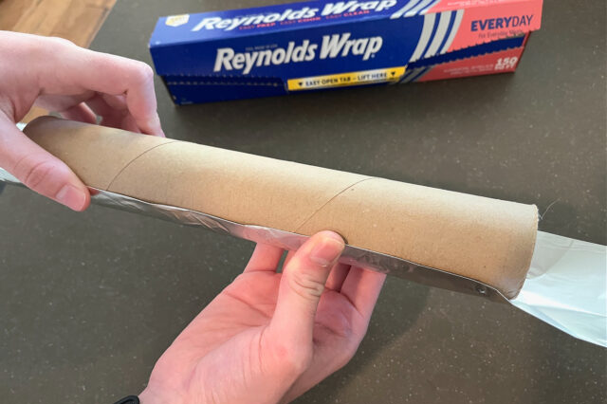
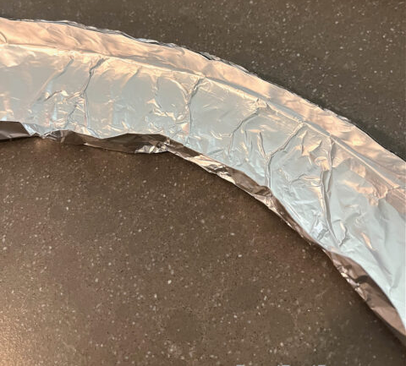
How Do Sediments Settle from Suspension?
To get a nice even river shape, it can be helpful to fold the foil around an empty paper towel roll.
Then, start shaping the foil to make a river with curves in it.
You’ll want the bottom of your river to be as flat as possible. For this experiment, we are testing the effect of the curves. We don’t want the elevation of the river bed to be a factor!
NOTE: You don’t want the curves to be NARROWER than the rest of the river. Narrow spots will make the river speed up, or if they are really narrow they may cause the water to pool behind them. Try to make your river a uniform width.

Slide 50
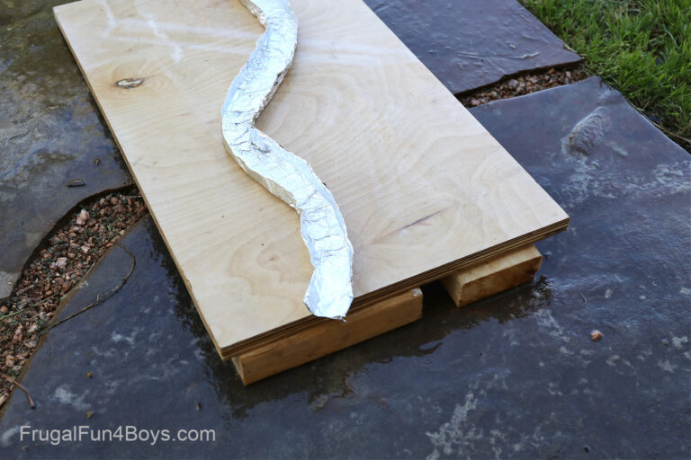
How Do Sediments Settle from Suspension?
Once you’ve made your foil river, set it up at a slant by using a board to support it.
Put a couple small blocks of wood under one end of the board. You don’t want much of a slant! If the water moves too quickly, the sediment won’t deposit on the river bottom.

Slide 51
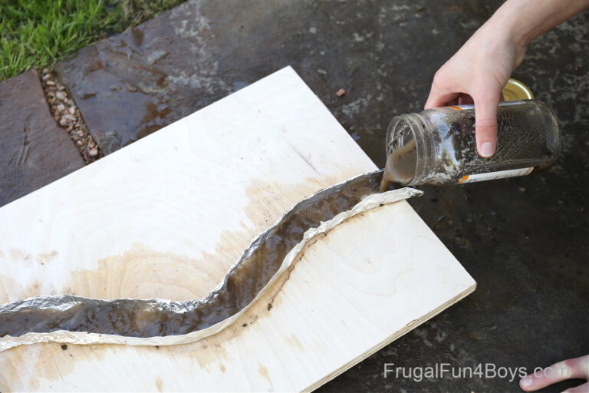
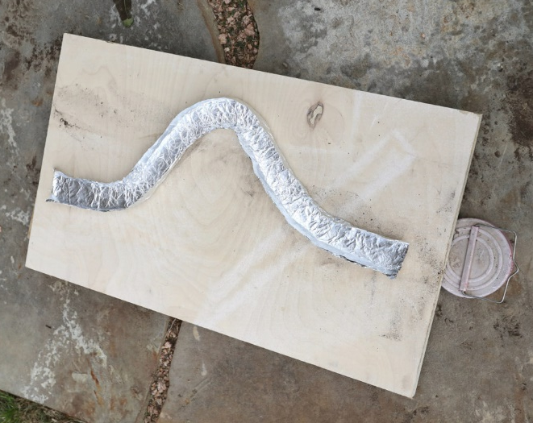
How Do Sediments Settle from Suspension?
Mix 1 teaspoon of sand, 1 teaspoon of dirt, and 2 teaspoons of gravel in approximately 2 cups of water in your jar and shake it up. Observe if the sand, dirt, and rocks are suspended in the water.
Then pour the muddy water into your riverbed!
You can visibly see the water moving more slowly on the inside of the curves! Watching larger pieces of sediment move along is helpful for observing the water speed.
You will see more sediment deposited on the insides of the curves, but will you get more dramatic result with bigger curves?
Try adjusting your river by making a bigger curve.

Slide 52
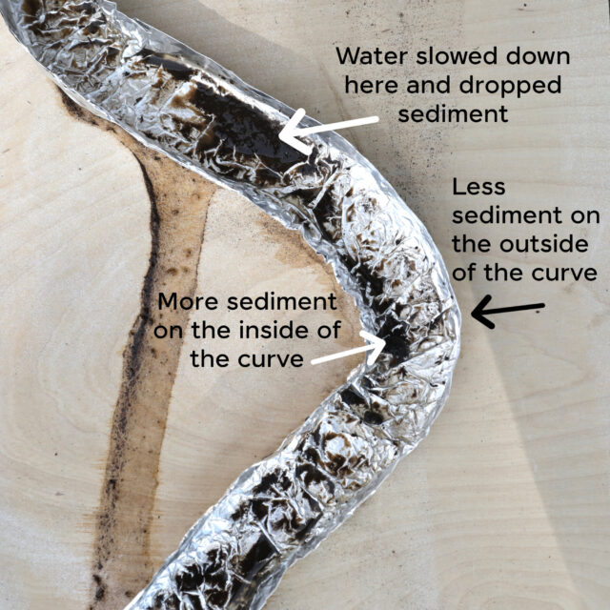
How Do Sediments Settle from Suspension?
Try several runs with your muddy water river.
Where does the sediment settle out?
To try additional runs on your river, rinse it with clean water between runs.
What else causes sediment to drop?
Foil wrinkles mimics rocks and fallen tree branches that would be found on a river bed.

Slide 53
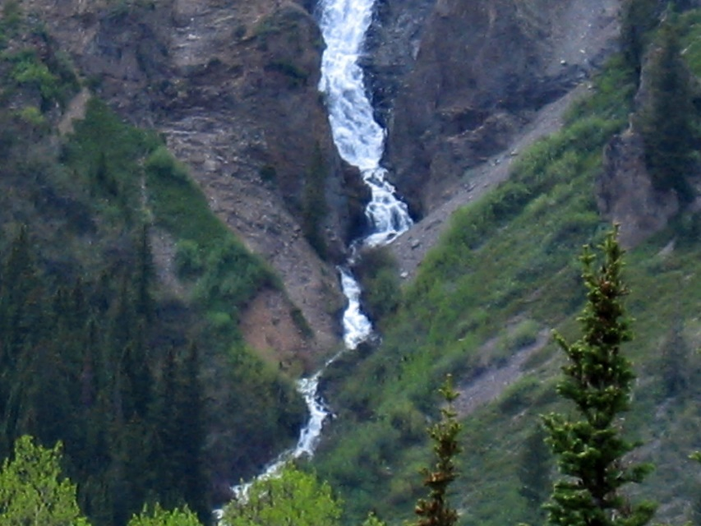
How Do Sediments Settle from Suspension?
Try Testing Additional Variables
Compare different water speeds by changing the slant of the board. How does this affect deposition of sediment throughout the river?
Compare particle size by using just sandy water and then muddy water. What differences in sedimentation do you notice?

Slide 54
How Do Sediments Settle from Suspension?
Observations
When you mixed the sand, dirt, and gravel in the water, did they become suspended? What settled first after you stopped mixing? What do you think would settle first in a streambed?
When you poured the mixture down the mountain slope, did the sand, gravel, or dirt settle out first?
Where on the mountainside did the sand tend to settle, on the point bar or the cut bank? Where did the gravel tend to settle? Where did the dirt tend to settle?
As the incline increased and the mountain grew higher, what happened to the amount of sediment that settled on the mountainside?

Slide 55
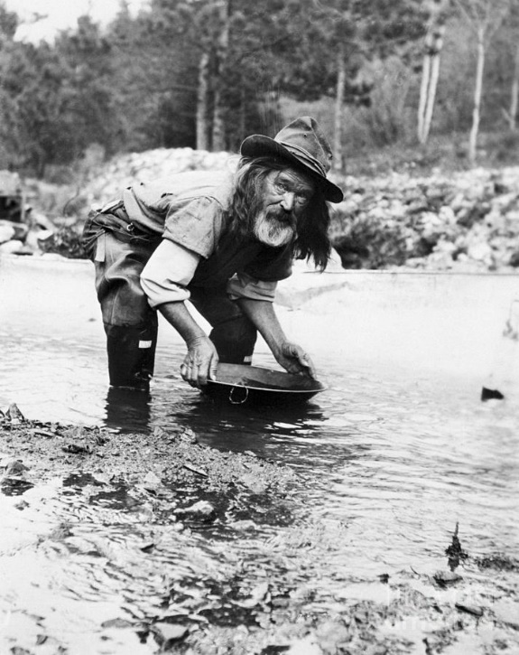
How Do Sediments Settle from Suspension?
Conclusions
When searching for something in a river, be it oil in an ancient river that flowed years ago, gold for the gold rush prospector, or a dropped Scout compass in a stream, it is helpful to know where heavier items settle when flowing downstream. Larger heavier materials like rocks settle out first. The faster the stream flows, the less the suspended solids settle out. The stream moves more slowly when the mountainside is not as high. Sediment of all sizes will settle out when they slow down going around a point bar. Only the heaviest rocks will settle out in a cut bank area. These same principles apply whether in a raging river, a gurgling brook, or a straight or twisting stream.

Slide 56
Requirement #5
Do all of the following:
  Surface and Sedimentary Processes Option
    Conduct an experiment approved by your counselor that demonstrates how sediments settle from suspension in water. Explain to your counselor what the exercise shows and why it is important.
    Using topographical maps provided by your counselor, plot the stream gradients (different elevations divided by distance) for four different stream types (straight, meandering, dendritic, trellis). Explain which ones flow fastest and why, and which ones will carry larger grains of sediment and why.
    On a stream diagram, show areas where you will ,find the following features: cut bank, fill bank, point bar, medial channel bars, lake delta. Describe the relative sediment grain size found in each feature.
    Conduct an experiment approved by your counselor that shows how some sedimentary material carried by water may be too small for you to see without a magnifier.
    Visit a nearby stream. Find clues that show the direction of water flow, even if the water is missing. Record your observations in a notebook, and sketch those clues you observe. Discuss your observations with your counselor.

Slide 57
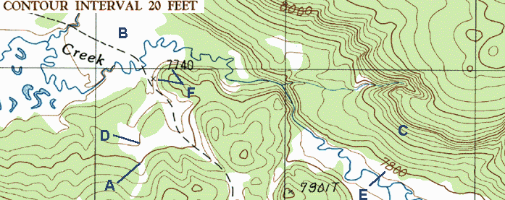
Reading Topographic Maps for Stream Gradient
Stream Patterns
The shape of a stream channel, or shape of the stream flow, also can determine the strength of a stream’s energy.
A geologist can predict the range of stream gradient and stream energy by looking at a map or an aerial photograph.

Slide 58
Reading Topographic Maps for Stream Gradient
Straight Streams
When a stream flows in a channel without significant bends, geologists say it flows straight. Most commonly a straight stream is one that has so much energy and flows so fast that it manages to erode its own channel regardless of rock type. Straight streams tend to have steep sides and the most energy. They can push large rocks and even boulders downhill. Straight streams demonstrate the fastest stream velocity and usually indicate that the stream is dropping fast from a higher elevation to a lower elevation. The stream shows you the direction of the downhill slope even if you do not have a topographic map.
Straight stream map view
Straight stream perspective view

Slide 59
Reading Topographic Maps for Stream Gradient
Meandering Streams
Meandering streams twist and turn in a snakelike pattern, usually in wide, flat areas. When a stream gradient is low, the stream slows down. Then external factors, like friction between the water and the bank or channel bottom, also can affect stream flow. Meandering, curving streams occur where the water current is not strong enough to force its way directly to base level, but only plays back and forth across a (mostly) flat area. Meandering streams are often close to a larger body of water (base level) like a lake, ocean, or a larger river. In time, this action is exaggerated. The slower zone in the stream begins to drop grains of sediment, which makes the channel shallower as it fills the channel bottom. In a shallow channel, the water flow spreads across more area and creates more friction, which slows the water even more, and so on. Meandering streams tend to have the slowest flow and the lowest stream gradient (energy level).
Meandering stream map view
Meandering stream perspective view

Slide 60
Reading Topographic Maps for Stream Gradient
Dendritic Streams
Streams that have a dendritic pattern, resembling the veins in a leaf, tend to be made up of both straight and meandering stream segments. This pattern is most common in areas of varying elevation as in hilly or mountainous terrains. Water from one side of a ravine will run to the bottom and join with water from the other side of the ravine. The combined stream will flow down the valley until it joins another runoff stream from a neighboring valley. Because water always runs downhill, the intersection of two streams makes a south-pointing arrow pattern on a map. Dendritic streams occupy the middle ground between straight streams and meandering streams, where the stream is still dropping from high ground to low ground, but where the drop is not as steep. There is still enough energy to show a primary direction of flow.
Dendritic stream map view
Dendritic stream perspective view

Slide 61
Reading Topographic Maps for Stream Gradient
Trellis Streams
Trellis stream patterns are not as common as other patterns. They display a stream pattern influenced entirely by the underlying rocks. In an area where the rocks have been folded, or thrust-faulted, the surface rocks occur in a pattern of parallel ridges. Water will flow along the valley between these ridges until it finds a gap that allows it to escape and flow down to the next level. Although these streams don’t flow in a straight line, they flow in very straight segments and their valley walls probably are steep-sided. Trellis streams may have very high energy and very fast water. The softer rocks, which erode more easily than others, erode from between the harder layers and leave behind ridges of higher ground. These parallel ridges print their pattern into the stream pattern because the water always runs downhill through the eroded valleys and flows around the higher ridges.
Trellis stream map view
Trellis stream perspective view

Slide 62
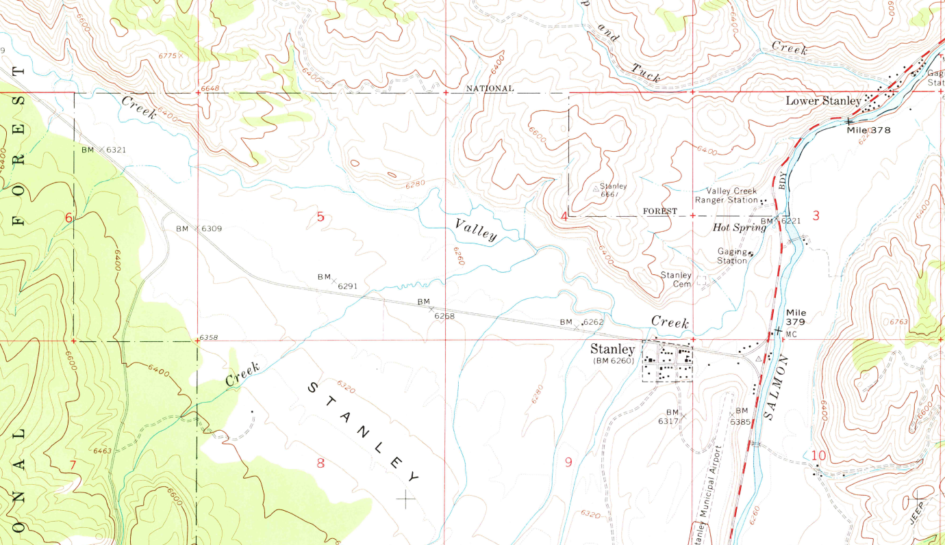
Reading Topographic Maps for Stream Gradient
Download the Stanley, ID topographic map included with this presentation to do the following exercise.

Slide 63
Reading Topographic Maps for Stream Gradient
Procedure
Step 1—Use the contour map that accompanies this presentation and identify the types of streams found on the map.
Step 2—Find a starting and ending place on the map where a stream crosses contour lines. Measure as closely as possible the distance on the map between the points with a ruler and convert it to feet or miles using the scale on the map. If the distance is in miles, multiply it by 5,280 to convert it to feet.
Step 3—Read the elevation of the stream at the beginning and ending points you selected in the last step. Often not all contour lines are labeled, but the interval is the change in elevation between each contour line. Use this information to find the elevation of the contour lines that cross the stream.
Step 4—Calculate the stream gradient—the ratio of elevation change to distance. Stream gradients are expressed in ratio form so they can be reduced to the lowest common denominator.
Step 5—Repeat steps 1 through 4 with the other types of streams on the map.

Slide 64
Reading Topographic Maps for Stream Gradient
Observations
Which type of stream flows the fastest. Why?
Which type of stream flows the slowest. Why?
Which type of stream would carry the largest grains of sediment? Why?
What kind of stream gradient would a waterfall have? Do waterfalls flow fast or slow?
Conclusions
Straight streams tend to have the highest gradient and the most energy, and therefore are able to carry the most sediment. Meandering streams normally have the lowest gradients and the least energy, and are able to carry only the smallest sediments.

Slide 65
Requirement #5
Do all of the following:
  Surface and Sedimentary Processes Option
    Conduct an experiment approved by your counselor that demonstrates how sediments settle from suspension in water. Explain to your counselor what the exercise shows and why it is important.
    Using topographical maps provided by your counselor, plot the stream gradients (different elevations divided by distance) for four different stream types (straight, meandering, dendritic, trellis). Explain which ones flow fastest and why, and which ones will carry larger grains of sediment and why.
    On a stream diagram, show areas where you will find the following features: cut bank, fill bank, point bar, medial channel bars, lake delta. Describe the relative sediment grain size found in each feature.
    Conduct an experiment approved by your counselor that shows how some sedimentary material carried by water may be too small for you to see without a magnifier.
    Visit a nearby stream. Find clues that show the direction of water flow, even if the water is missing. Record your observations in a notebook, and sketch those clues you observe. Discuss your observations with your counselor.

Slide 66


Stream Landforms
Cut Bank
On the meandering stream with its S-shaped curves, the force of water pushes on the outside of the bend. The rushing water continues to erode, or cut away, the outside of the bend named the cut bank. Just as a race car in the outer lane of a bend has to travel faster to keep up with a race car on an inner lane, the water on the outside of a river bend travels faster than water on the inside of a bend. Because the water in a cut bank is high stream energy, flowing quickly, it often picks up dirt and sediment, eroding the cut bank. Typically no grains will settle in this area.

Slide 67

Stream Landforms
Point Bar and Fill Bank
While the water on the outside of a bend travels quickly, the water on the inside slows down and has low stream energy. This creates an area where the bigger or the heavier grains are dropped. Where the inside of a river bend often fills with sediment is called a fill bank or point bar.

Slide 68

Stream Landforms
Delta
Deltas form where a stream flows into a lake or ocean and drops its sediment. Deltas can show different patterns of deposition but there is usually an area where the delta ends and the slope drops quickly into deeper water. Stream channels can occur within a delta. As long as the stream has any energy to flow it will continue to maintain its form and transport grains to the delta slope where the stream energy drops to zero.

Slide 69

Stream Landforms
Medial Channel Bar
An elongated mound of sediment in the middle of a channel or waterway is a medial channel bar, sometimes called a sandbar. A delta may have a number of medial channel bars in the waterway where the sediment settles as the flow slows entering a lake or ocean. Grains settle out like in a delta.

Slide 70
Requirement #5
Do all of the following:
  Surface and Sedimentary Processes Option
    Conduct an experiment approved by your counselor that demonstrates how sediments settle from suspension in water. Explain to your counselor what the exercise shows and why it is important.
    Using topographical maps provided by your counselor, plot the stream gradients (different elevations divided by distance) for four different stream types (straight, meandering, dendritic, trellis). Explain which ones flow fastest and why, and which ones will carry larger grains of sediment and why.
    On a stream diagram, show areas where you will ,find the following features: cut bank, fill bank, point bar, medial channel bars, lake delta. Describe the relative sediment grain size found in each feature.
    Conduct an experiment approved by your counselor that shows how some sedimentary material carried by water may be too small for you to see without a magnifier.
    Visit a nearby stream. Find clues that show the direction of water flow, even if the water is missing. Record your observations in a notebook, and sketch those clues you observe. Discuss your observations with your counselor.

Slide 71

Finding Sediment With a Magnifying Glass
Procedures
Step 1—With your parent’s permission and a Scout buddy, visit a nearby stream. Using a clear plastic cup, scoop up some stream water. Using a magnifying glass, look at the water for suspended sedimentary materials. Write down your observations.
Step 2—Find a second location along the stream, perhaps near a fill bank, and scoop up a second sample. Examine it with a magnifying glass and make notes.
Step 3—If you have access to a microscope, maybe at your school, save a sample of stream water and look at the same water through the microscope. You may have to stir or shake the water before making your microscope slide.

Slide 72

Finding Sediment With a Magnifying Glass
Fine sediment can be found in nearly any body of water, carried along by the water flow.
When the sediment is floating within the water column it is considered suspended.
The faster the water flows, the bigger the particles that can be suspended in the water column.

Slide 73
Finding Sediment With a Magnifying Glass
Observations
Were you able to see more sediment with the magnifying glass?
Was there more sediment in the first or second sample?
If you were able to use a microscope, what did you observe?
Even though some of this sediment is too small to see without magnification, do you think when the river drops this sediment it impacts the stream bottom? Why?
Conclusions
Some sediment is too small to see without magnification. Rivers and streams move materials in a large variety of sizes, from large boulders to fine grains too small to be seen with the naked eye. Water flowing over our planet is constantly changing the shape of its surface.

Slide 74
Requirement #5
Do all of the following:
  Surface and Sedimentary Processes Option
    Conduct an experiment approved by your counselor that demonstrates how sediments settle from suspension in water. Explain to your counselor what the exercise shows and why it is important.
    Using topographical maps provided by your counselor, plot the stream gradients (different elevations divided by distance) for four different stream types (straight, meandering, dendritic, trellis). Explain which ones flow fastest and why, and which ones will carry larger grains of sediment and why.
    On a stream diagram, show areas where you will ,find the following features: cut bank, fill bank, point bar, medial channel bars, lake delta. Describe the relative sediment grain size found in each feature.
    Conduct an experiment approved by your counselor that shows how some sedimentary material carried by water may be too small for you to see without a magnifier.
    Visit a nearby stream. Find clues that show the direction of water flow, even if the water is missing. Record your observations in a notebook, and sketch those clues you observe. Discuss your observations with your counselor.

Slide 75
Water Direction
Procedures
Step 1—With your parent’s permission and a Scout buddy, visit a nearby stream. Look at the water to see what direction it is flowing. Drop a stick, leaf, or other natural material on the water to confirm this direction. Even if the water has dried up, look for clues that show the direction of the previous water flow.
Step 2—Look for a second stream feeding into this stream.
Step 3—Look for an obstruction in the stream like a rock or tree. (On an obstruction, sediment will build up on the upstream side and the downstream side may be hollowed out.)
Step 4—Look for debris like twigs and leaves wrapped around trees and rocks along the bank.
Step 5—Look for reeds, grass, litter bending toward downstream.
Step 6—Record all your observations with notes and sketches in a notebook. Share your observations with your counselor.

Slide 76
Water Direction
Observations
Are you able to see sediment being carried by the stream current?
If you found a second stream feeding into the first stream did they form a V where they converged? What direction did the V point, upstream or downstream?
What type of obstruction did you find? What had collected on the upstream side of the obstacle? Was the downstream side of the obstacle hollowed out?
Did you find twigs and leaves wrapped around trees and rocks? Did the height of this debris indicate the stream once overflowed its banks?
Conclusions
Even if a stream has dried up, many clues indicate the direction of the water flow. Often two joining streams will form a V pointing downstream. Obstructions like trees and rocks collect sediments as the water slows to pass around it. All streams leave water-flow direction clues.

Slide 77

Water Direction
Which way is this stream flowing?
How can you tell?

Slide 78


